Slide 1
Unified GPU Programming in Julia: Vendor Abstraction and High-Level Control with KernelAbstractions
Evelyne Ringoot
Rabab Alomairy
SC25, St. Louis
with material by Valentin Churavy

Slide 2

Introduction to Julia for easy GPU parallelism and portability
How Julia Abstractions provide easy parallelism on 2D heat diffusion
High-level hardware description of GPU
Matrix Multiplication : CUDA C++ vs CUDA.jl vs KernelAbstractions.jl
Hands on: 2D Heat Diffusion Simulation Using Stencil Computation in Julia

Slide 3
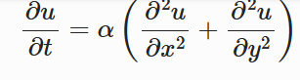
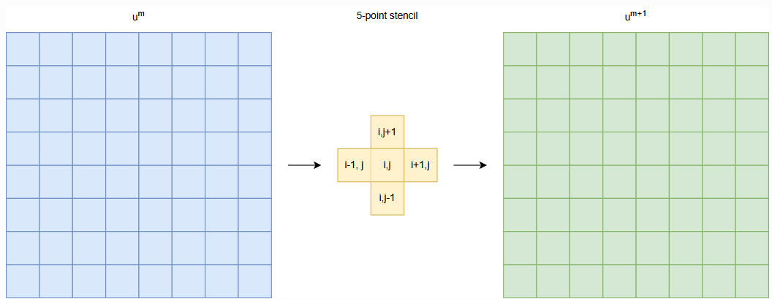
2D Heat diffusion
Every interior point diffuses to its neighbours
Source https://enccs.github.io/gpu-programming/13-examples/

Slide 4
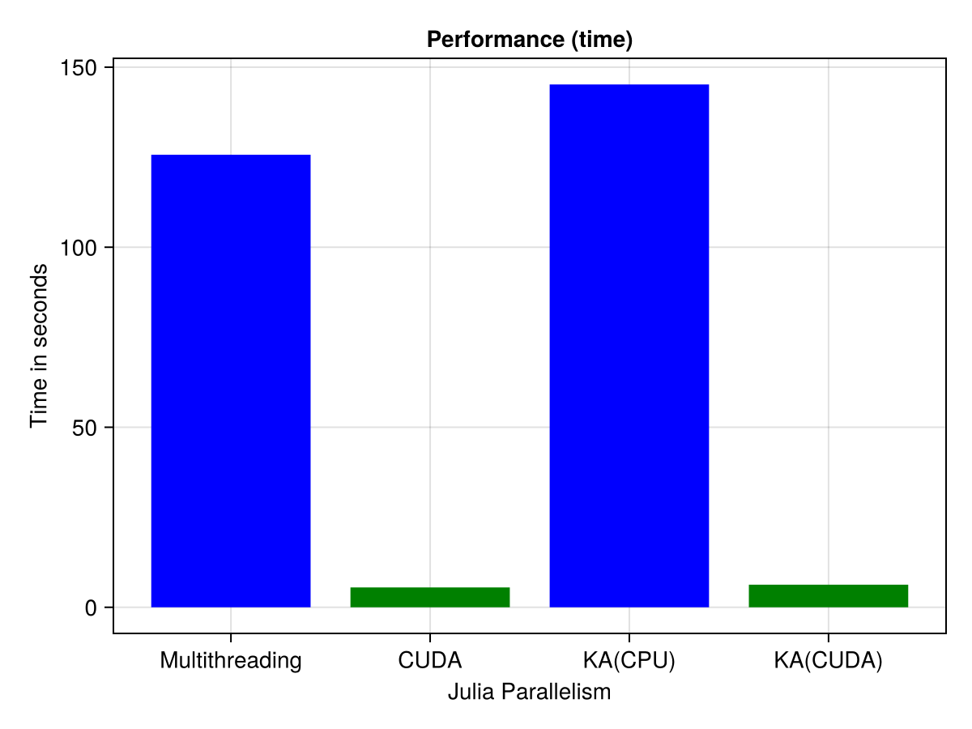
2D Heat Diffusion Simulation in Julia
The grid size is 10240x10240 and number of time steps 2000.
Comparing performance of Julia parallelism paradigms:
Multithreading (CPU)
125s
Time in seconds
GPU (CUDA)
5s
Single A100 GPU in Perlmutter

Slide 5
2D Heat Diffusion Simulation in Julia
The grid size is 10240x10240 and number of time steps 2000.
Comparing performance of Julia parallelism paradigms:
KernelAbstractions (single API)
Multithreading (CPU)
CPU
149s
125s
Time in seconds
GPU (CUDA)
5s
6s
GPU
Single A100 GPU in Perlmutter

Slide 6
Julia ease of use
Performance gains
GPU faster than CPU
Flexibility vs. Performance
Kernel Abstraction is flexible with slight performance trade-off
Ease of Use
Seamless integration
Readability and maintainability
149s
125s
Even less effort
Minimal effort
Time in seconds
5s
6s
Multithreading
CUDA
KA(CPU)
KA(CUDA)
Single A100 GPU in Perlmutter
2D Heat Diffusion Simulation in Julia

Slide 7
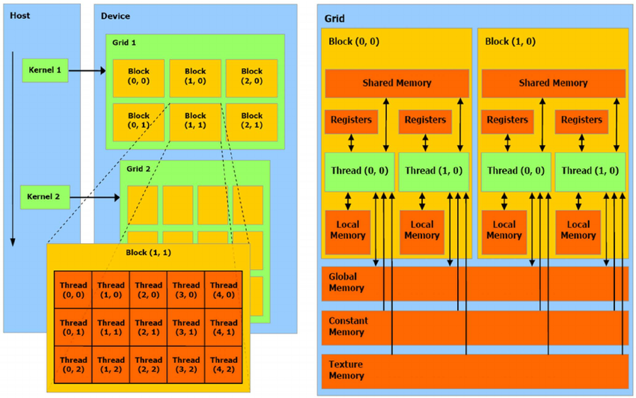
Basics of a GPU
Single-Instruction-Multiple-Threads (SIMT).
SIMT allows GPUs to execute the same instruction across multiple threads
Perspective is a thread
Threads grouped into blocks of up to 1024 threads that execute the same instruction in parallel
Blocks grouped into GPU-wide grids
Threads within block can access shared memory and synchronize, blocks cannot(*)

Slide 8
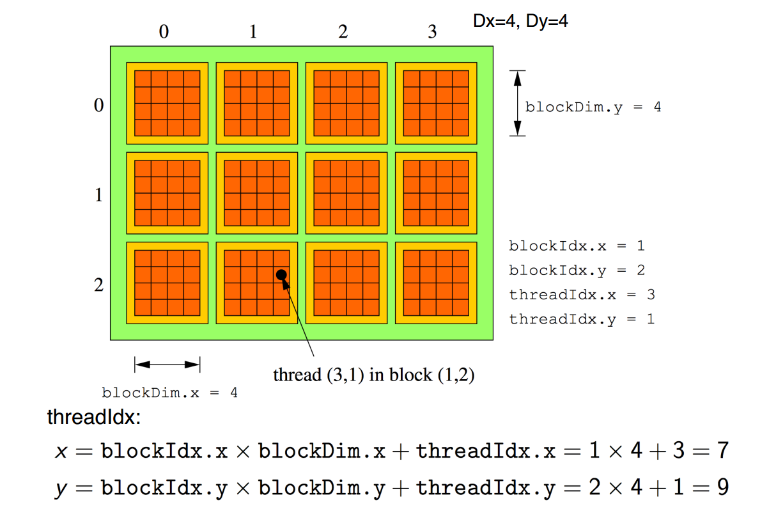
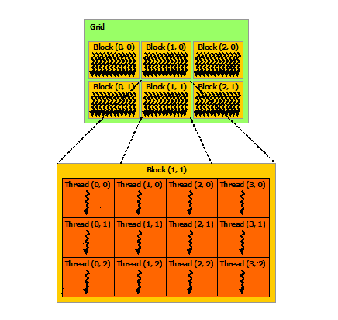
Programming model
Grid
x
Block
y
Global thread ID: the position of the thread within block (threadIdx) , the position of the block within the grid (blockIdx), and block dimension (blockDim)

Slide 9
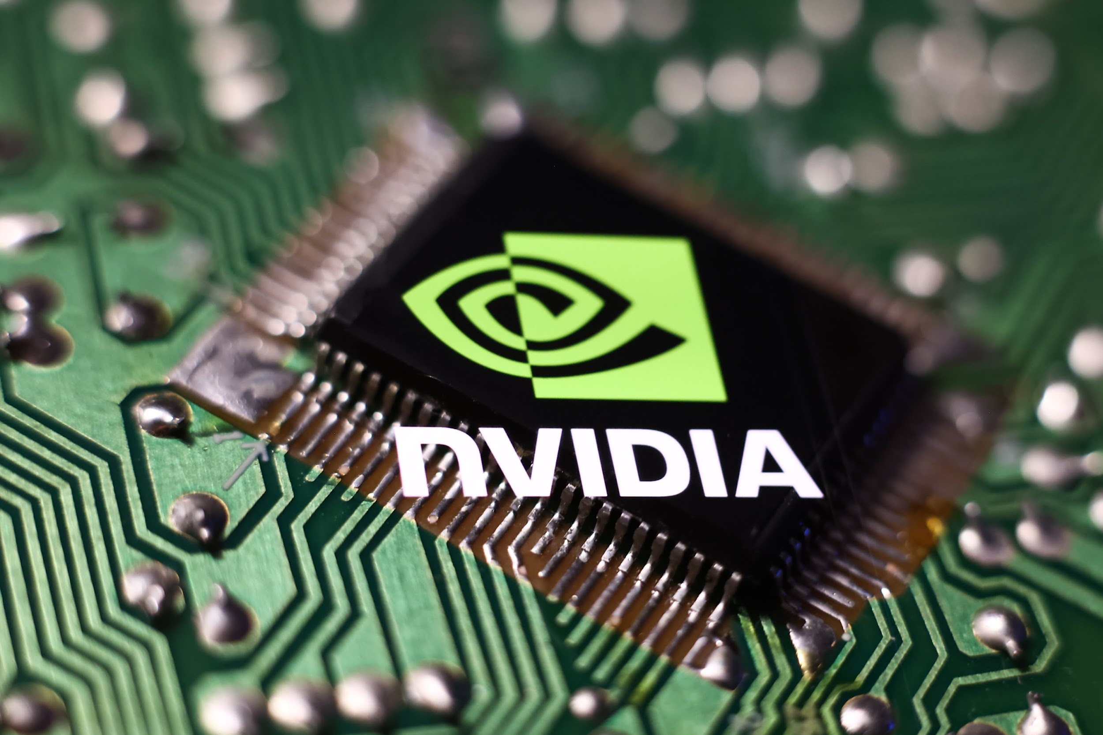
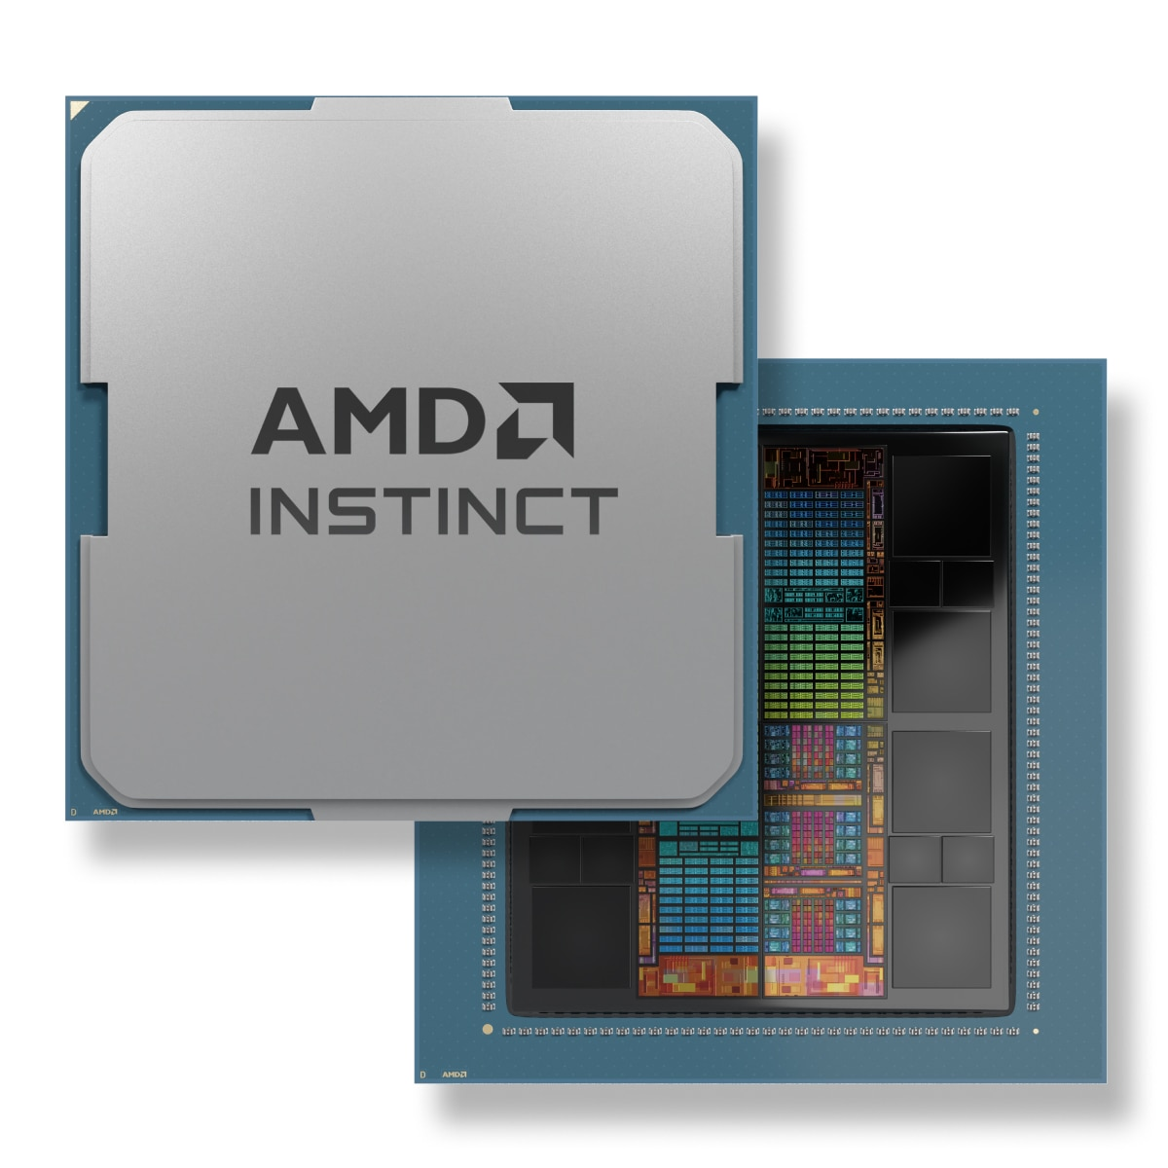
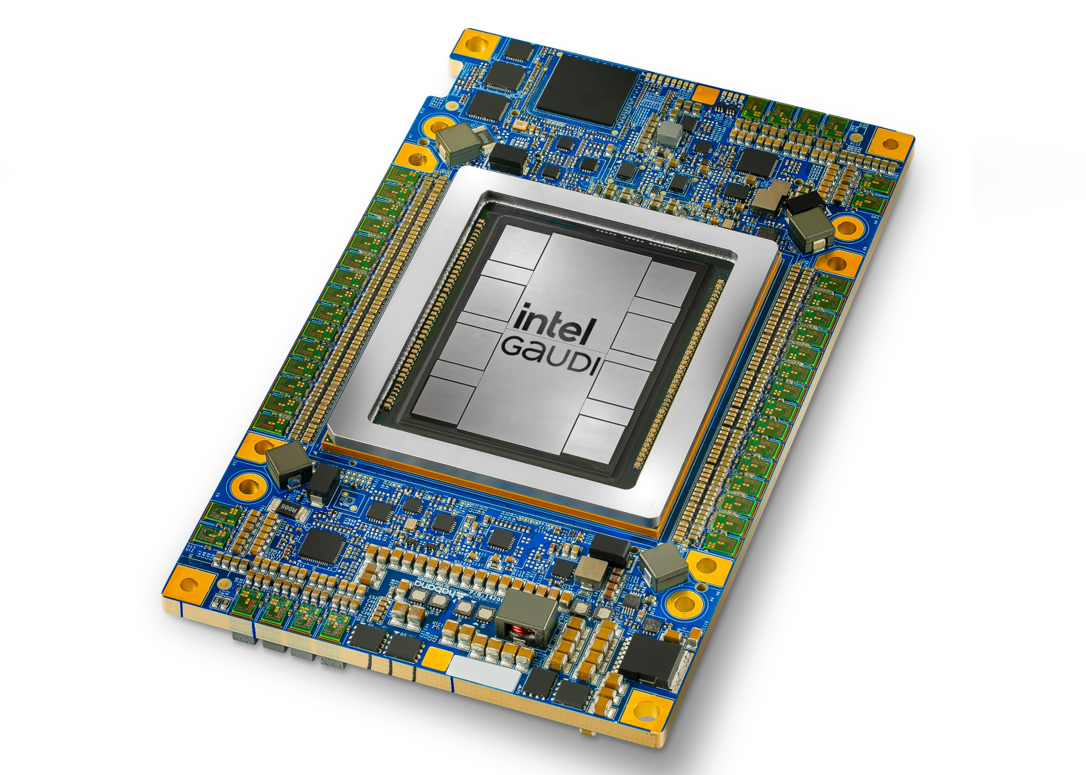

Existing GPUs and their Software
Hardware | NVIDIA | AMD | Intel | Apple
Software | CUDA | ROCm | OneAPI | Metal

Slide 10
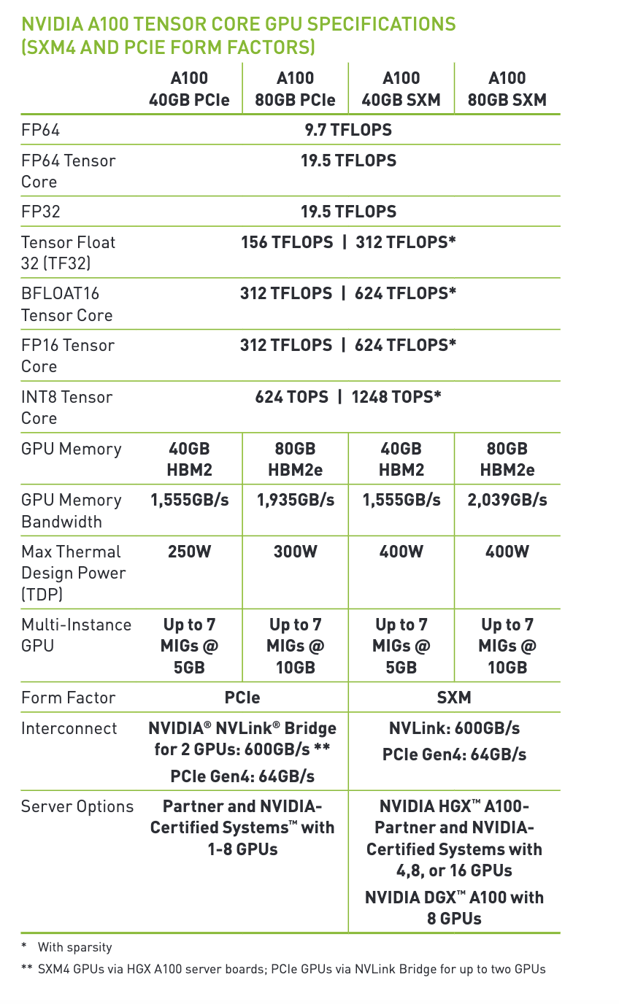
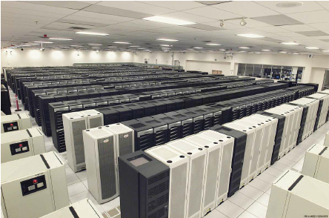
NVIDIA Ampere A100
An NVIDIA A100 GPU contains 108 Streaming Multiprocessors (SMs)
It has 40 MB L2 cache, which helps reduce latency
It supports up to 80 GB of HBM2 memory with a maximum memory bandwidth of 2039 GB/s , essential for handling large data and reducing data transfer.
It contains in total 6912 FP32/INT32 CUDA cores and 3456 FP64 CUDA cores
NVIDIA H100: offers up to 30 TFLOPs of FP64 performance, which is over 3x the FP64 performance of the A100
GB200 Grace Blackwell Superchip: Provides 90 TFLOPS of FP64 performance
ASCI White supercomputer
Lawrence Livermore National Laboratory
Top #1 in 2007, 7.9 TFLOPS

Slide 11
Vector Addition Example
CPU code
GPU (CUDA) kernel
vector_size = 1024
a = rand(1:4, vector_size)
b = rand(1:4, vector_size)
c = zeros(Int, vector_size)
function vadd(c, a, b)
for i in 1:vector_size
c[i] = a[i] + b[i]
end
return
end
da = CuArray(a)
db = CuArray(b)
dc = CUDA.zeros(Int, size(a))
function vadd(c, a, b)
i = threadIdx().x + (blockIdx().x - 1) * blockDim().x
c[i] = a[i] + b[i]
return
end
@cuda threads=length(a) vadd(dc, da, db)

Slide 12
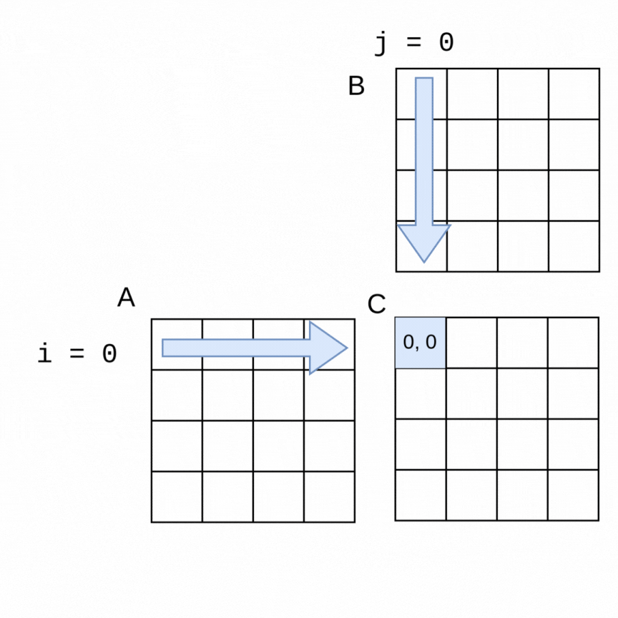
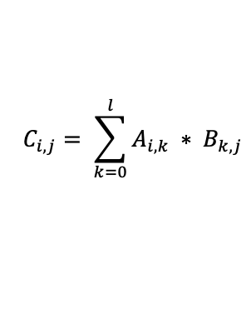
Matrix Multiplication Example
Matrix multiplication for computing each element of matrix C from matrices A and B can be written:
for i in 0:m-1
for j in 0:n-1
C[i, j] = 0
for k in 0:l-1
C[i, j] += A[i, k] * B[k, j]
end
end
end

Slide 13
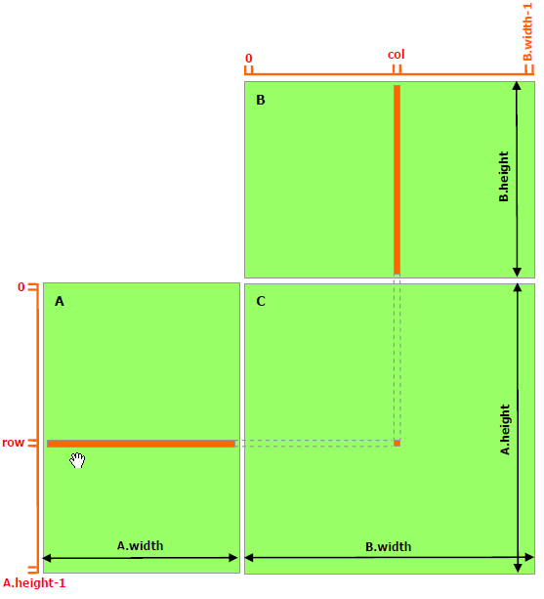

Matrix Multiplication Example (CUDA C++ )
1. __global__ void MatMulKernel(const Matrix, const Matrix, Matrix);
2.
3. void MatMul(const Matrix A, const Matrix B, Matrix C)
4. {
5. Matrix d_A;
6. d_A.width = A.width; d_A.height = A.height;
7. size_t size = A.width * A.height * sizeof(float);
8. cudaMalloc(&d_A.elements, size);
9. cudaMemcpy(d_A.elements, A.elements, size, cudaMemcpyHostToDevice);
10. Matrix d_B;
11. d_B.width = B.width; d_B.height = B.height;
12. size = B.width * B.height * sizeof(float);
13. cudaMalloc(&d_B.elements, size);
14. cudaMemcpy(d_B.elements, B.elements, size, cudaMemcpyHostToDevice);
15.
16. Matrix d_C;
17. d_C.width = C.width; d_C.height = C.height;
18. size = C.width * C.height * sizeof(float);
19. cudaMalloc(&d_C.elements, size);
20.
21. dim3 dimBlock(BLOCK_SIZE, BLOCK_SIZE);
22. dim3 dimGrid(B.width / dimBlock.x, A.height / dimBlock.y);
23. MatMulKernel<<<dimGrid, dimBlock>>>(d_A, d_B, d_C);
24.
25. cudaMemcpy(C.elements, d_C.elements, size,
26. cudaMemcpyDeviceToHost);
27.
28. cudaFree(d_A.elements);
29. cudaFree(d_B.elements);
30. cudaFree(d_C.elements);
31. }
32.
33. __global__ void MatMulKernel(Matrix A, Matrix B, Matrix C)
34. {
35. float Cvalue = 0;
36. int row = blockIdx.y * blockDim.y + threadIdx.y;
37. int col = blockIdx.x * blockDim.x + threadIdx.x;
38. for (int e = 0; e < A.width; ++e)
39. Cvalue += A.elements[row * A.width + e]
40. * B.elements[e * B.width + col];
41. C.elements[row * C.width + col] = Cvalue;
42. }
1024
Matrix size: 1024 x 1024
Block size: 16 x 16
Grid dimension: 64 x 64
16
1024
16
CUDA C++ Programming Guide
https://docs.nvidia.com/cuda/cuda-c-programming-guide/index.html?highlight=matrix%20multiply

Slide 14
CUDA.jl kernel
using CUDA
function MatrixMultiplication!(A,B,C)
row = (blockIdx().x - 1) * blockDim().x + threadIdx().x
col = (blockIdx().y - 1) * blockDim().y + threadIdx().y
sum = zero(eltype(C))
if row <= size(A, 1) && col < size(B, 2)
for i = 1:size(A, 2)
sum += A[row, i] * B[i, col]
end
C[row, coll] = sum
end
return
end

Slide 15
CUDA.jl
using CUDA
function MatrixMultiplication!(A,B,C)
row = (blockIdx().x - 1) * blockDim().x + threadIdx().x
col = (blockIdx().y - 1) * blockDim().y + threadIdx().y
sum = zero(eltype(C))
if row <= size(A, 1) && col < size(B, 2)
for i = 1:size(A, 2)
sum += A[row, i] * B[i, col]
end
C[row, coll] = sum
end
return
end
CPU array
a = rand(1024, 1024)
b = rand(1024, 1024)
A = CuArray(a)
B = CuArray(b)
C = CUDA.zeros(1024, 1024)
threads = (16, 16)
blocks = (64, 64)
@cuda threads=threads blocks=blocks MatrixMultiplication!(A, B, C)
c = Array(C)
GPU array
Allocate and transfer to GPU
GPU resident
Lunch GPU kernel
Allocate and transfer to CPU

Slide 16
AMDGPU.jl
using AMDGPU
function MatrixMultiplication!(A, B,C)
row = (workgroupIdx()).x - 1) * workgroupDim(). x + workitemIdx().x
col = (workgroupIdx()).y - 1) * workgroupDim(). y + workitemIdx()).y
sum = zero (eltype(C))
if row <= size(A, 1) 8& col <= size(B, 2)
for 1 = 1:size(A, 2)
sum += A[row, i] * B[i, col]
end
C[row, col] = sum
end
return
end
a = rand(1024, 1024)
b = rand(1024, 1024)
A = ROCArray(a)
B = ROCArray(b)
C = AMDGPU.zeros(1024, 1024)
threads = (16, 16)
blocks = (64, 64)
@roc groupsize=threads gridsize=blocks MatrixMultiplication!(A, B, C)
c = Array(C)

Slide 17
oneAPI.jl and Metal.jl
using oneAPI
function MatrixMultiplication!(A,B,C)
row = get_global_id(0)
col = get_global_id(1)
sum = zero(eltype(C))
if row <= size(A, 1) && col <= size(B, 2)
for i = 1:size(A, 2)
sum += A[row, i] * B[i, col]
end
C[row, col] = sum
end
return
end
using Metal
function MatrixMultiplication!(A, B,C)
row, col = thread_position_in_grid_2d()
sum = zero(eltype(C))
if row <= size(A, 1) && col <= size(B, 2)
for i = 1:size(A, 2)
sum += A[row, i] * B[i, col]
end
C[row, col] = sum
end
return
end

Slide 18




gets its Power from Extensible Compiler Design
Language design
GPU
AST
xPU back end
IR
Efficient execution
CPU
GPU
Julia: Dynamism and Performance Reconciled by Design Bezanson J. et al (doi:10.1145/3276490)
Effective Extensible Programming: Unleashing Julia on GPUs
Besard T. et al (doi:10.1109/TPDS.2018.2872064)

Slide 19
GPUs from different vendors are similar
All of them are implicit vector architectures
All of them are focused around kernels => Programs that are launched on the host, and execute asynchronously on the device
KernelAbstractions.jl provides a shallow portability layer for GPUs from AMD, Intel, Apple and NVIDIA.

Slide 20
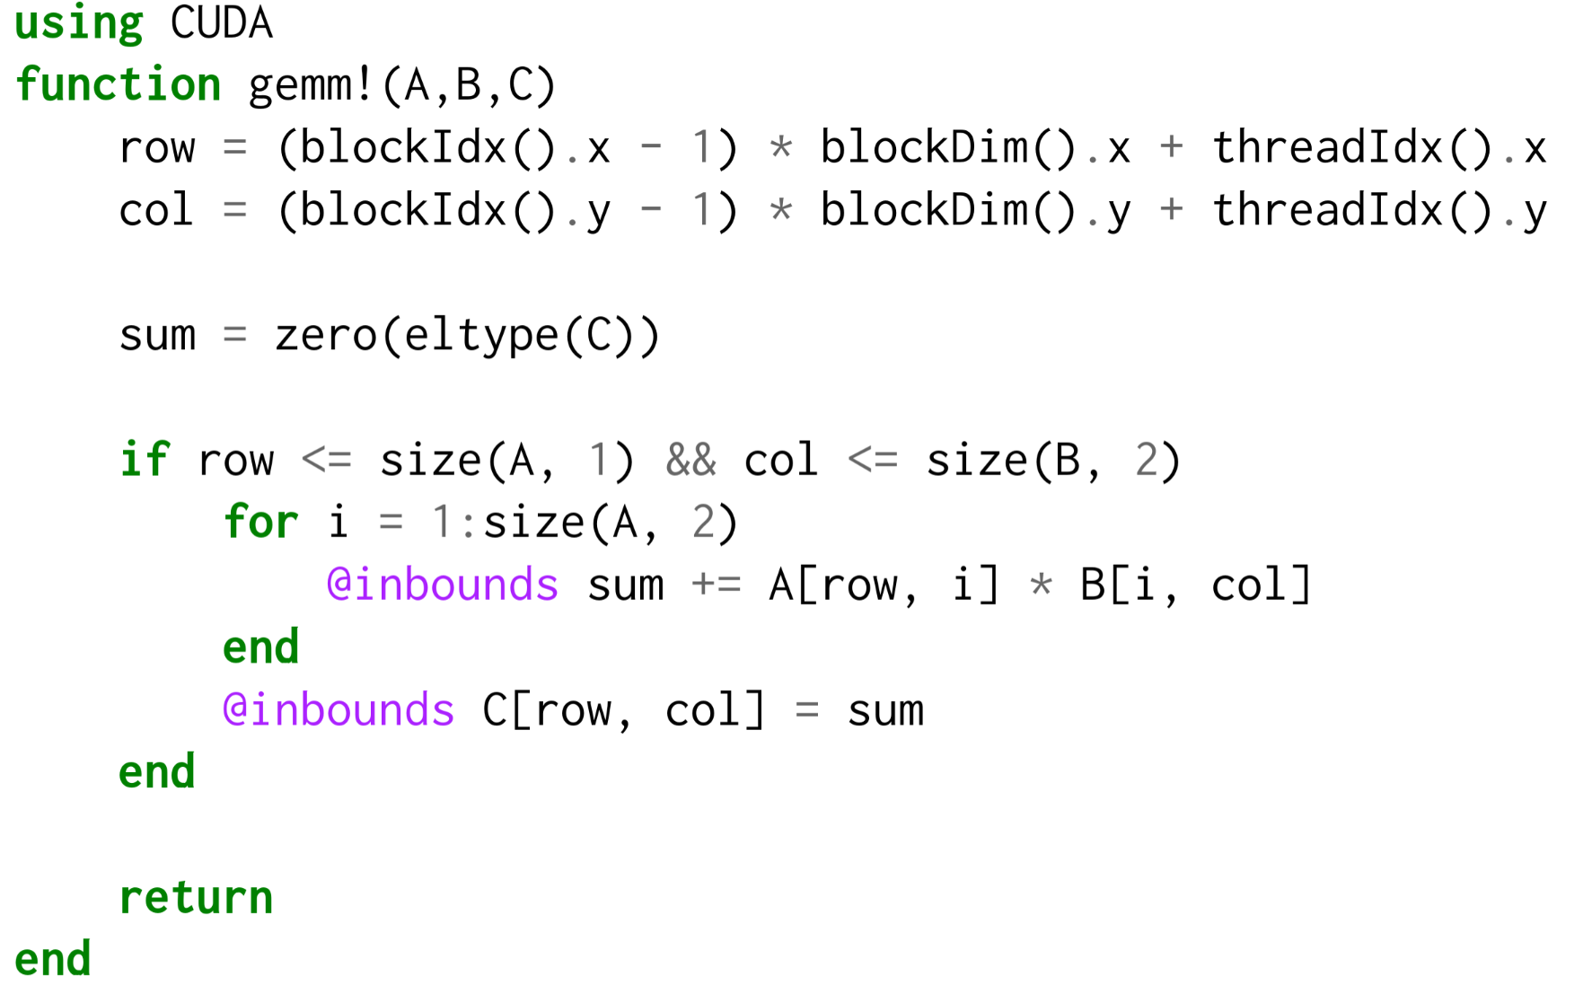
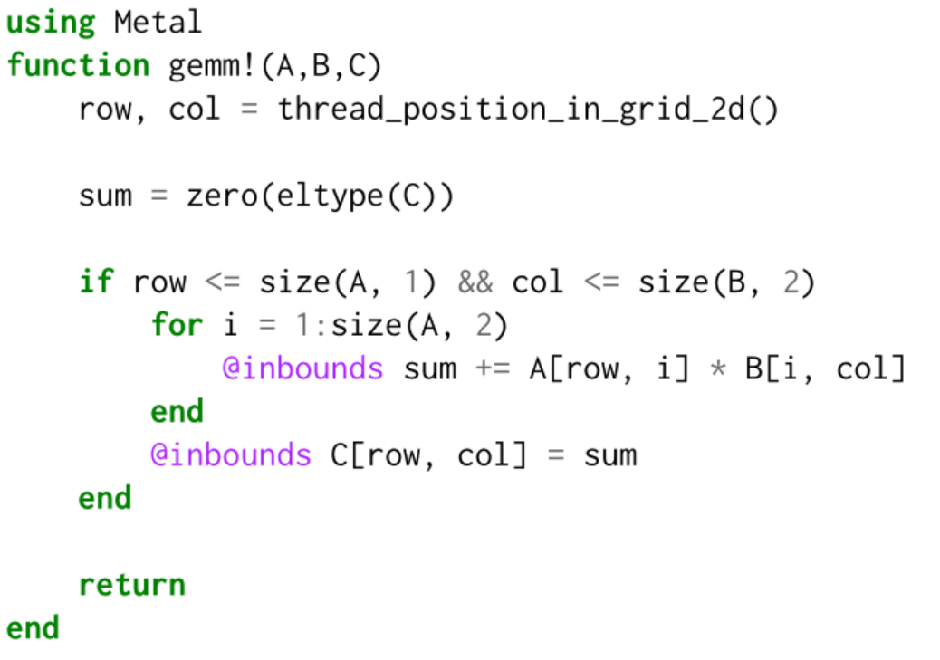
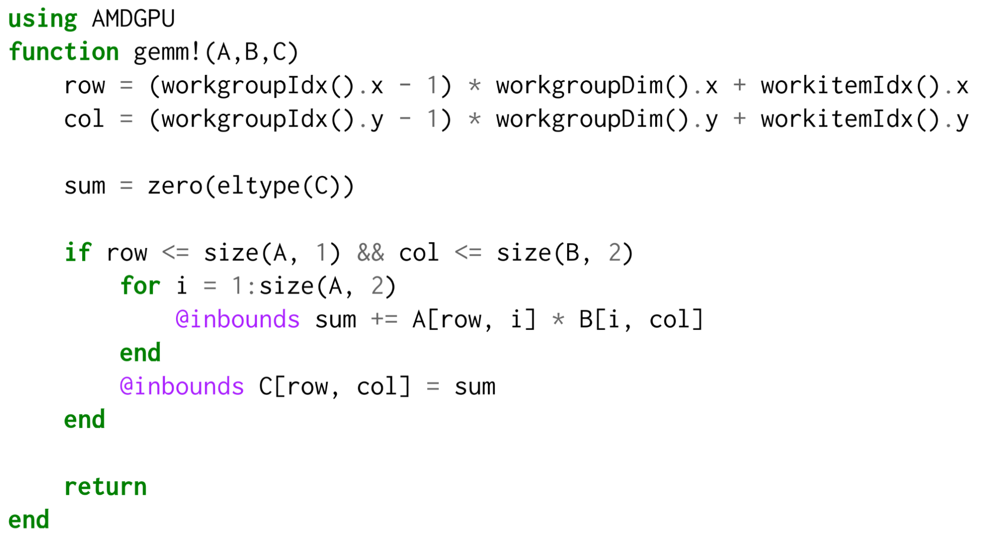
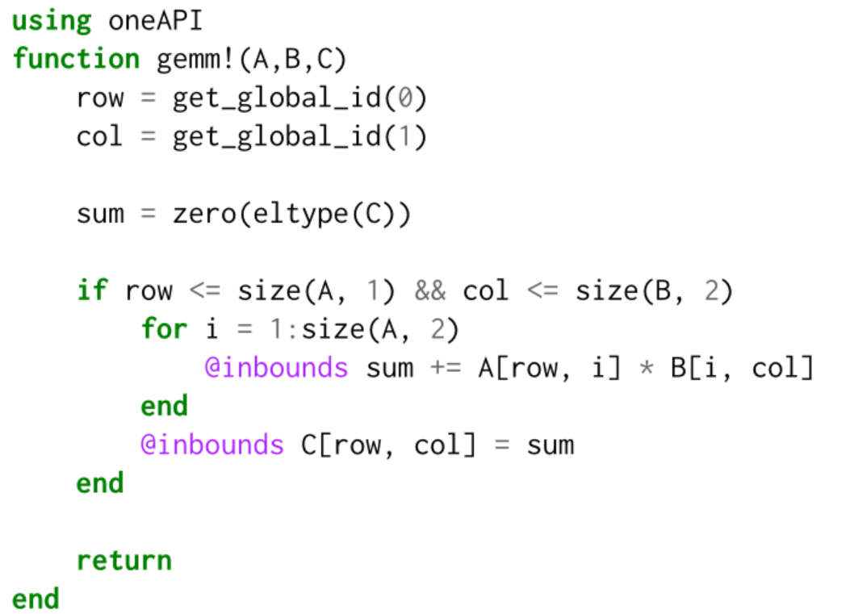
using KernelAbstractions
@kernel function MatrixMultiplication_kernel!(A, B, C)
row, col = @index(Global, NTuple)
sum = zero(eltype(C))
if row <= size(A, 1) && col <= size(B, 2)
for i = 1:size(A, 2)
sum += A[row, i] * B[i, col]
end
C[row, col] = sum
end
end

Slide 21
KernelAbstractions.jl
using KernelAbstractions
@kernel function MatrixMultiplication_kernel!(A, B, C)
row, col = @index(Global, NTuple)
sum = zero(eltype(C))
if row <= size(A, 1) && col <= size(B, 2)
for i = 1:size(A, 2)
sum += A[row, i] * B[i, col]
end
C[row, col] = sum
end
end
# Allocate and initialize GPU arrays
A = rand!(allocate(Backend, Type, 1024, 1024))
B = rand!(allocate(Backend, Type, 1024, 1024))
C = KernelAbstractions.zeros(Backend, Type, 1024, 1024)
# Compile the kernel for this workgroup (block) size
workgroupsize = (16, 16)
kernel! = MatrixMultiplication_kernel!(Backend, workgroupsize)
# Launch the kernel, and synchronize the current stream
kernel!(A, B, C, ndrange=(size(C)))
KernelAbstractions.synchronize(Backend)

Slide 22
Kernel language — @kernel
KernelAbstractions defines a language valid within @kernel definitions
@Const: Declares an argument to not be aliased or written to
@index: Which kernel element are we operating upon?
@localmem: Allocate local (shared) memory
@synchronize: Synchronize warps/wavefronts
@private: Allocate private memory for a lane
@print: Unified printing of device-side data
…

Slide 23
Kernel language: Indexing
Indexing Method:
@index(Global, Kind): Global index for accessing input arguments
@index(Group, Kind): Which work-group does the lane belong to?
@index(Local, Kind): Which item inside a work-group is this lane?
Indexing Kind:
@index(Locale, Cartesian): Index as a CartesianIndex
@index(Locale, NTuple): Index as a tuple
@index(Locale, Linear): Index as a scalar

Slide 24
Introduction to Julia for easy GPU parallelism and portability
How Julia Abstractions provide easy parallelism on 2D heat diffusion
High-level hardware description of GPU
Matrix Multiplication : CUDA C++ vs CUDA.jl vs KernelAbstractions.jl
Hands on: 2D Heat Diffusion Simulation Using Stencil Computation in Julia

